Slide 1
Pruning with pytorch
.pruning leads to unwanted weights to zero
1.Tested MAP( mean average precision ) with full precision and half precision
2.Tested MAP with full precision and global pruning amount = 0.4
3.Tested MAP with half precision and global pruning amount = 0.4
4.Tested MAP with full precision and global pruning amount = 0.6
5.Tested Map with full precision and locally (layer wise) pruning amount = 0.4
6.Tested Map with full precision and locally (layer wise) pruning amount = 0.5

Slide 2
Pruning and quantization

Slide 3
Global Pruning Results
Full precision (Float 32 ) and half precision (Float 16) results almost same , so only going with half precision
Compared to half precision with global pruning amount = 0.4,0.5,0.6
Global amount = 0.4 is best,
Before pruning number of parameters = 36905341
After pruning number of parameters = 24812661 and MAP = 0.502 (original = 0.512 without pruning )
With amount = 0.6 number of parameters reduced to 18766383 but MAP reduced to 0.401

Slide 4
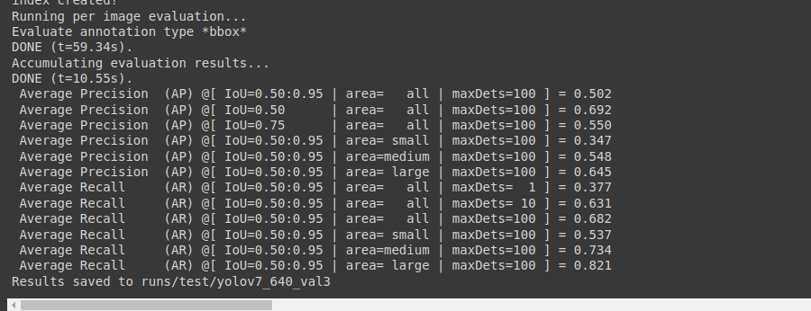
Half precision with global amount = 0.4

Slide 5
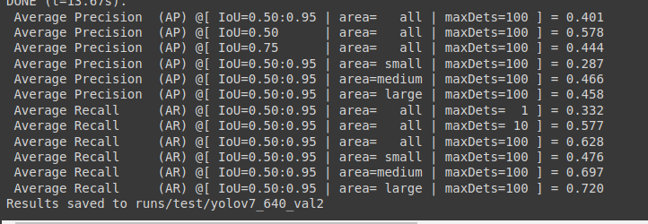
Half precision with global pruning amount = 0.6

Slide 6
Quantization
1.For the pretrained model in pytorch quantization can only done to nn.Linear,nn.GRU and nn.Lstm not to nn.Conv2d
2.so done quantization by converting to other formats like
3. But after pruning to save a sparse model used tflite and tflite model quantization to INT8 reduced model size to 32 MB ( half precision to 72 MB )
Pytorch
ONNX
Tensorflow
TFlite
TFlite model quantization

